Slide 1

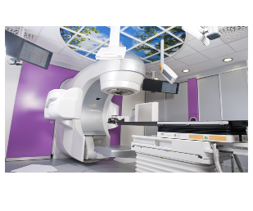

Personalisiertes Vorgehen im Bereich des Lymphabflusses
Update Bestrahlung
Wilfried Budach
Klinik für Strahlentherapie und Radioonkologie
Universitätsklinikum Düsseldorf

Slide 2
ESTRO consensus on CTV deliniation in early breast cancer
Offersen et al. Radiother Oncol 2015

Slide 3
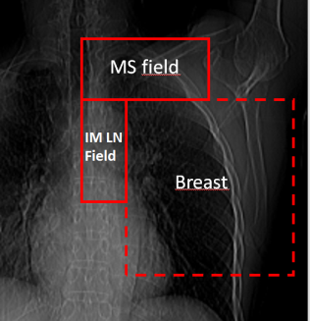
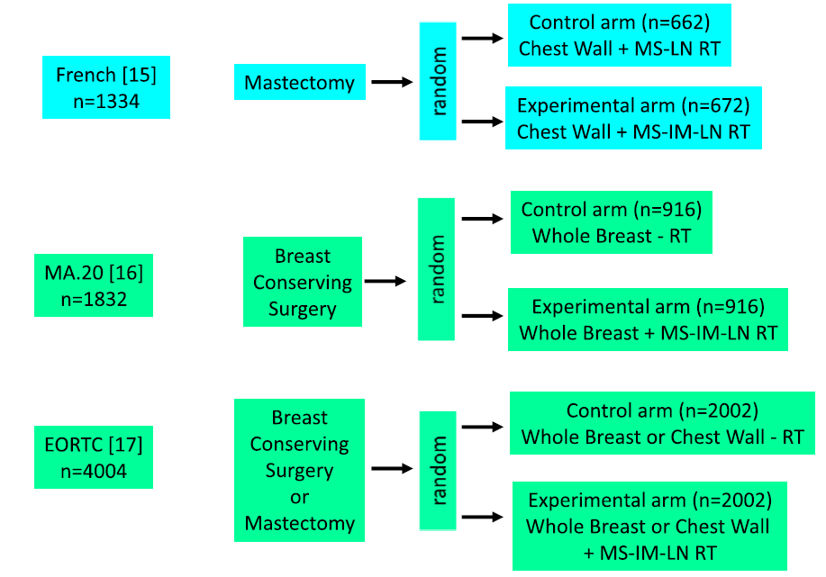
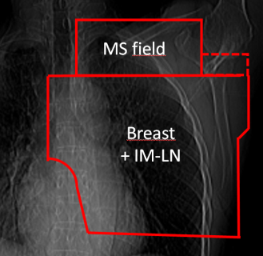
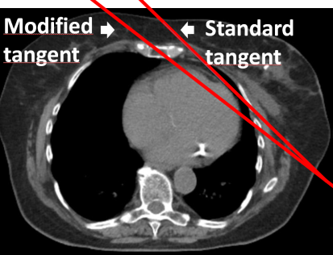
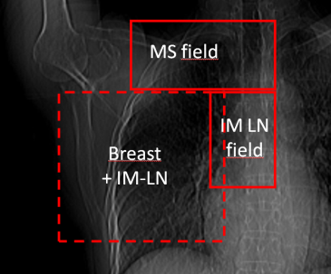
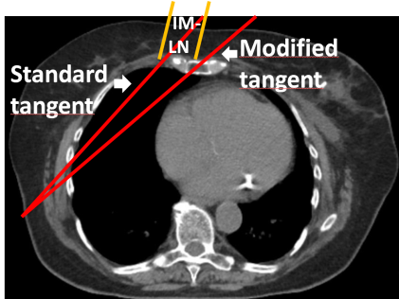
Figure 1
Radiotherapy to regional lymph nodes: Randomized trials
Radiation fields in experimental arms
[13]
[10]
[12]
W. Budach et al. Radiat Oncol 2015

Slide 4
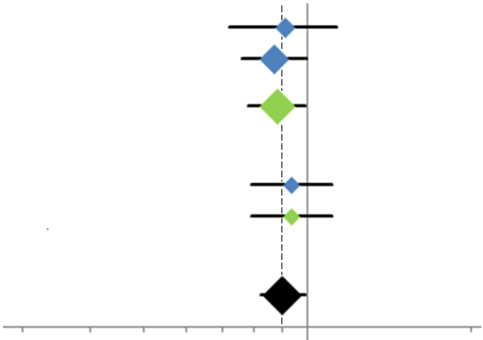
Update: Meta-Analysis on LN-irradiation in early breast cancer
Overall Survival
Comparison I: (MS+IM)+(WBI/CWI) vs. (WBI/CWI)
MA.20 [16]: n=1832; HR 0.91 (95% CL 0.72 - 1.13)
EORTC [17]: n=4004; HR 0.87 (95% CL 0.76 - 1.00)
Subtotal*: n=5836; HR 0.88 (95% CL 0.78 - 0.99) p=0.034
Comparison II: IM+(WBI/CWI+MS) vs. (WBI/CWI+MS)
French [15]: n=1334; HR 0.94 (95% CL 0.79 - 1.11)
Subtotal: n=1334; HR 0.94 (95% CL 0.79 - 1.11) p=0.80
Comparison I+II
Total**: n=7170; HR 0.90 (95% CL 0.82 - 0.99) p=0.031
0.3 0.4 0.5 0.6 0.8 1.0 2.0
Hazard Ratio
LN RT better no LN RT better
*= fixed effect model
** = random effect model
absolute benefit: +2%
W. Budach et al. Radiat Oncol 2015

Slide 5
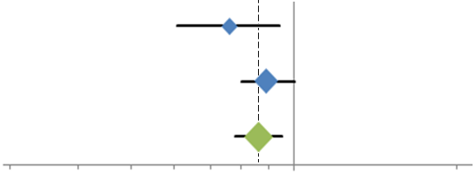
Update: Meta-Analysis on LN-irradiation in early breast cancer
Disease free survival
Comparison: (MS+IM)+(WBI/CWI) vs. (WBI/CWI)
MA.20 [16]: n=1832; HR 0.76 (95% CL 0.61 - 0.94)
EORTC [17]: n=4004; HR 0.89 (95% CL 0.80 - 1.00)
Total: n=5836; HR 0.86 (95% CL 0.78 - 0.95) p=0.003
0.3 0.4 0.5 0.6 0.8 1.0 2.0
Hazard Ratio
LN RT better no LN RT better
fixed effect model
absolute benefit: +4%
W. Budach et al. Radiat Oncol 2015

Slide 6

Update: Meta-Analysis on LN-irradiation in early breast cancer
Distant metastasis free survival
Comparison: (MS-IM)+(WBI/CWI) vs. (WBI/CWI)
MA.20 [16]: n=1832; HR 0.76 (95% CL 0.60 - 0.97)
EORTC [17]: n=4004; HR 0.86 (95% CL 0.76 - 0.98)
Total: n=5836; HR 0.84 (95% CL 0.75 – 0.94) p=0.002
0.3 0.4 0.5 0.6 0.8 1.0 2.0
Hazard Ratio
LN RT better no LN RT better
fixed effect model
absolute benefit: +3.5%
W. Budach et al. Radiat Oncol 2015

Slide 7
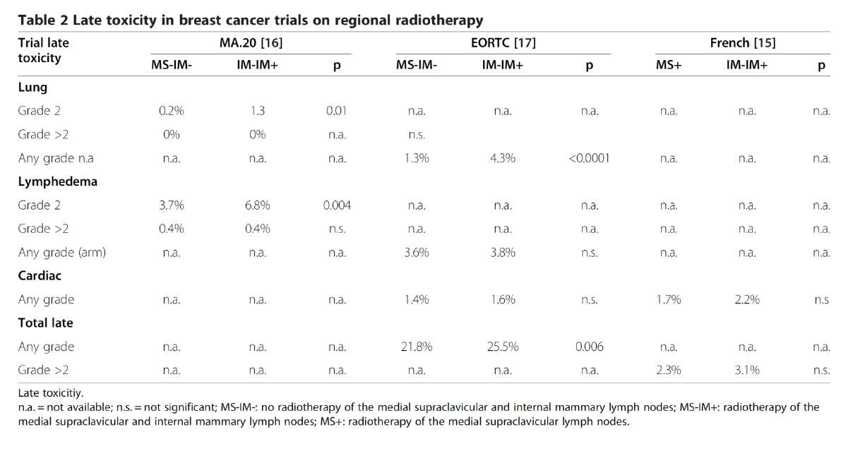
Meta-analysis: whole breast (WBI)/chest wall (CW) RT vs. WBI/CWI + regional lymph nodes
v
v
v
W. Budach et al. Radiat Oncol 2013

Slide 8
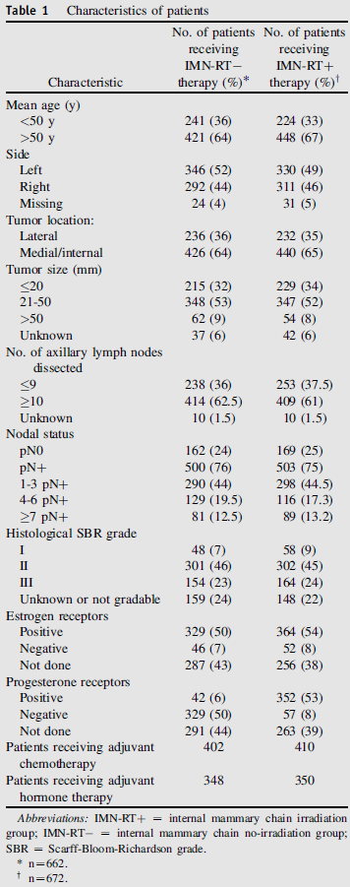
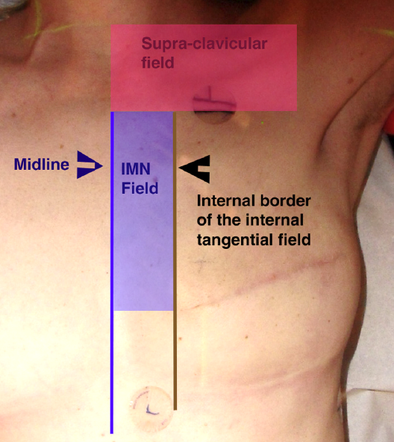
Frensh trial: chest wall + supraclav.-RT +/- IMC (random)
Hennequin et al. IJROBP 2013

Slide 9
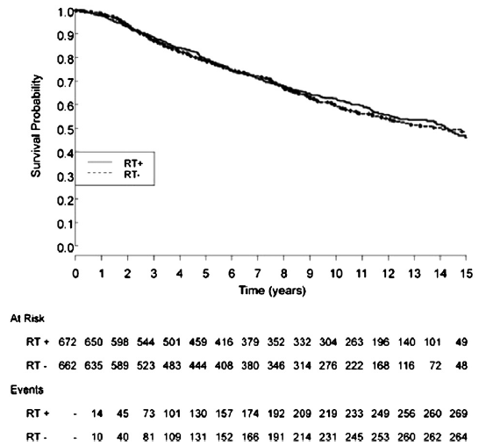
Frensh trial: chest wall + supraclav.-RT +/- IMC (random)
Overall Survival
Hennequin et al. IJROBP 2013

Slide 10
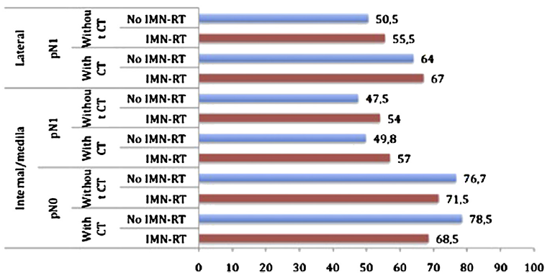

Frensh trial: chest wall + supraclav.-RT +/- IMC (random)
10 y. overall survival [%]
+5%
+3%
pN1
+6.5%
+7.2%
No IMC RT
IMC RT
Hennequin et al. IJROBP 2013

Slide 11
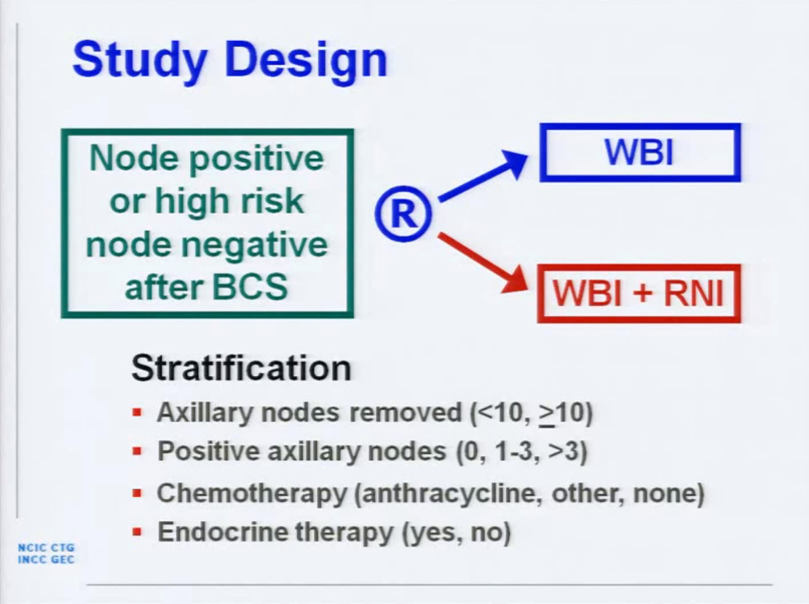
MA.20 trial: breast RT vs. breast RT + axillary/supraclavI IMC RT
Whelan et al. ASCO 2011

Slide 12
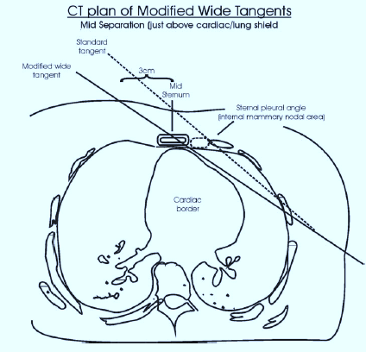
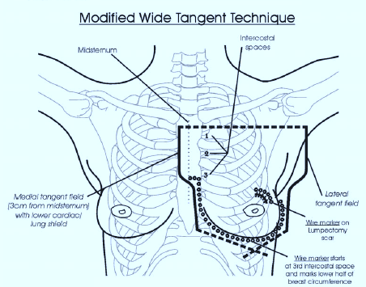
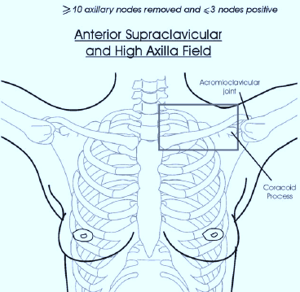
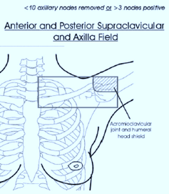
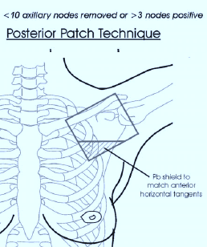
MA.20 trial: breast RT vs. breast RT + axillary/supraclav/IMC RT

Slide 13
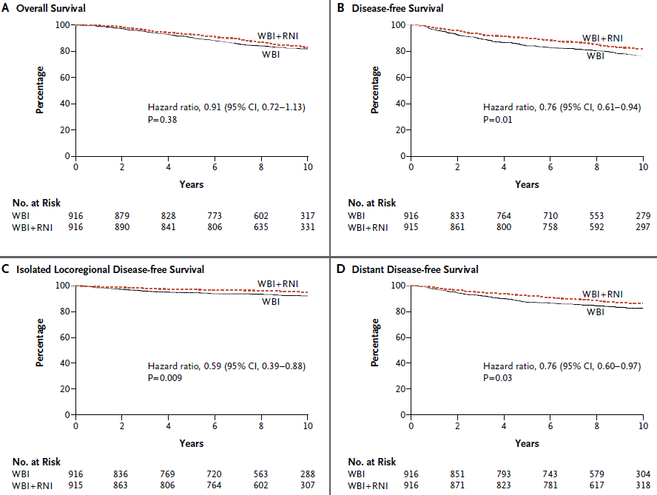
MA.20 trial: breast RT vs. breast RT + axillary/supraclav/IMC RT
Whelan et al. NEJM 2015

Slide 14
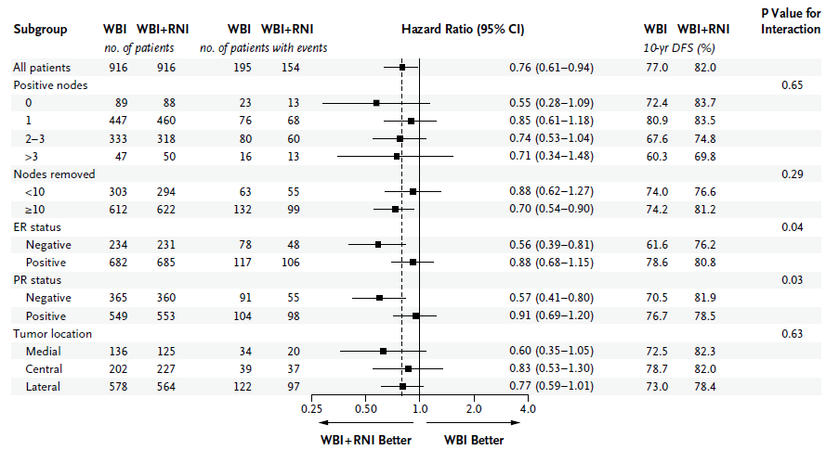
MA.20 trial: breast RT vs. breast RT + axillary/supraclav/IMC RT
Disease Free Survival
*
*
* = absolute benefit: +6%
Whelan et al. NEJM 2015

Slide 15
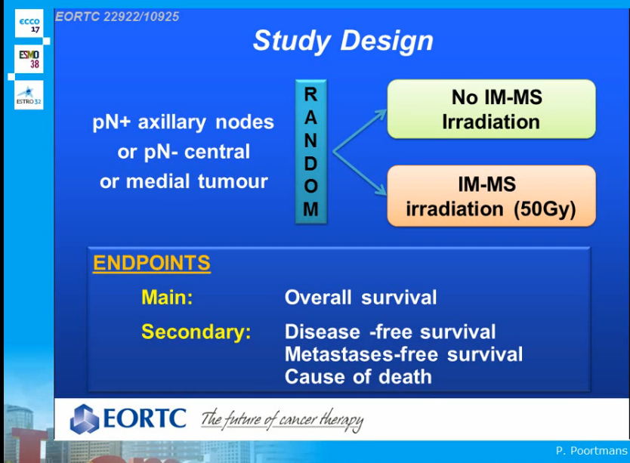
ECCO, Amsterdam 2013

Slide 16
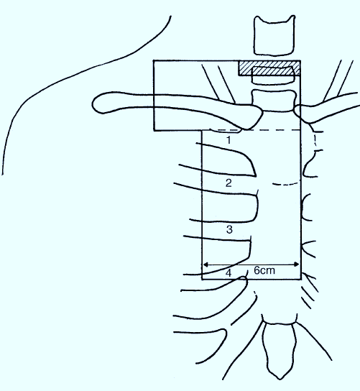
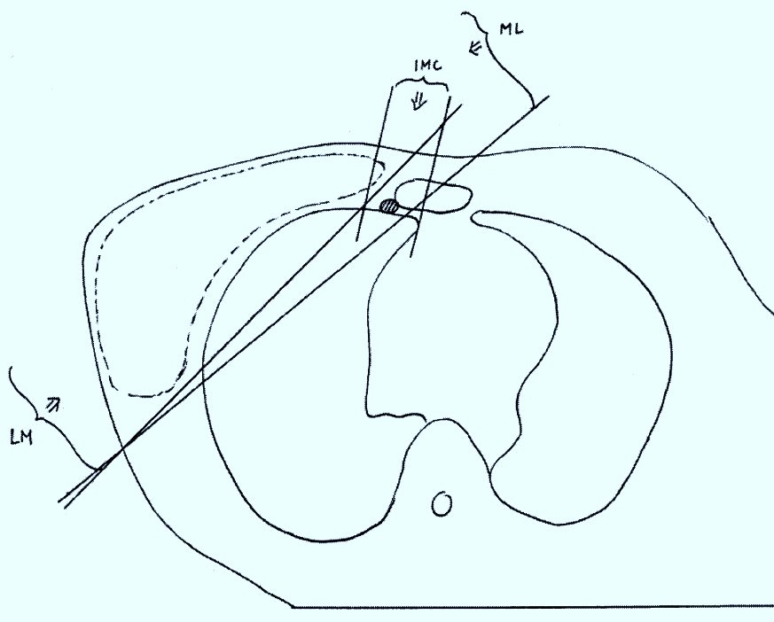
EORTC 22922/ trial: breast RT vs. breast RT + axillary/supraclav/IMC RT
Lievens et al. Radiother Oncol 2001

Slide 17
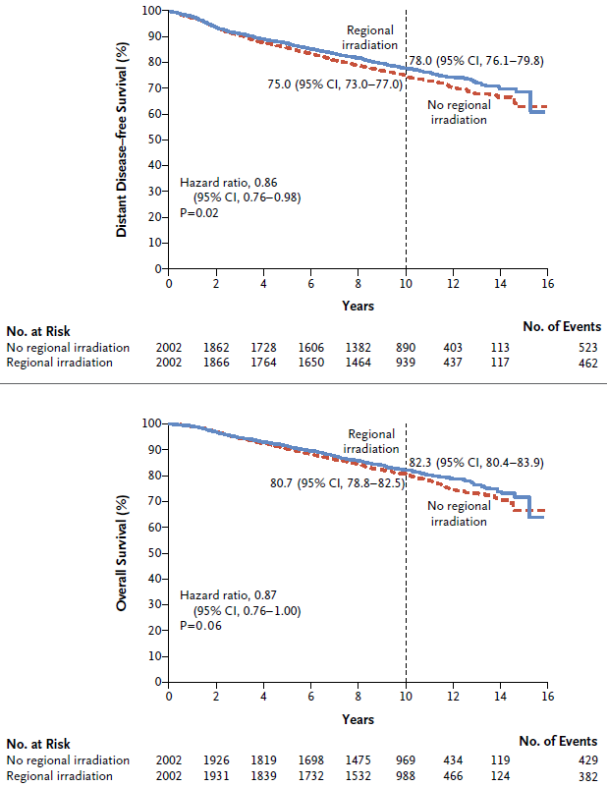
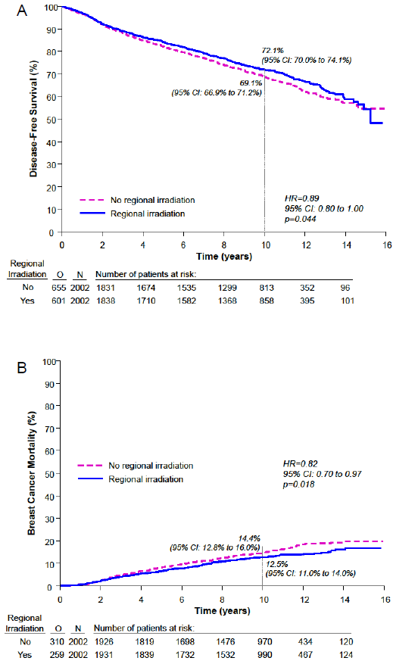
EORTC 22922/ trial: breast RT vs. breast RT + axillary/supraclav/IMC RT
DMFS
DFS
Breast Cancer Mortality
Overall Survival
Poortmans et al. NEJM 2015

Slide 18
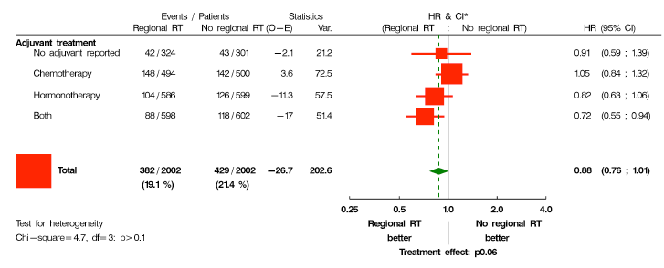
EORTC 22922/ trial: breast RT vs. breast RT + axillary/supraclav/IMC RT
End Point: Overall Survival
*
* = absolute benefit: +5%
Poortmans et al. NEJM 2015

Slide 19
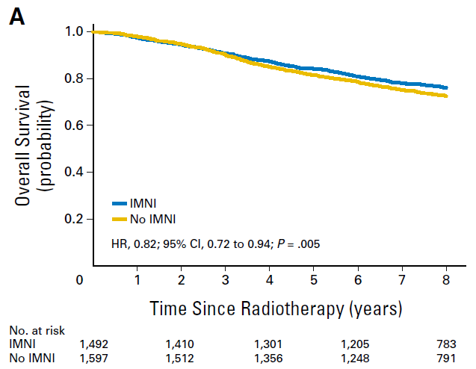
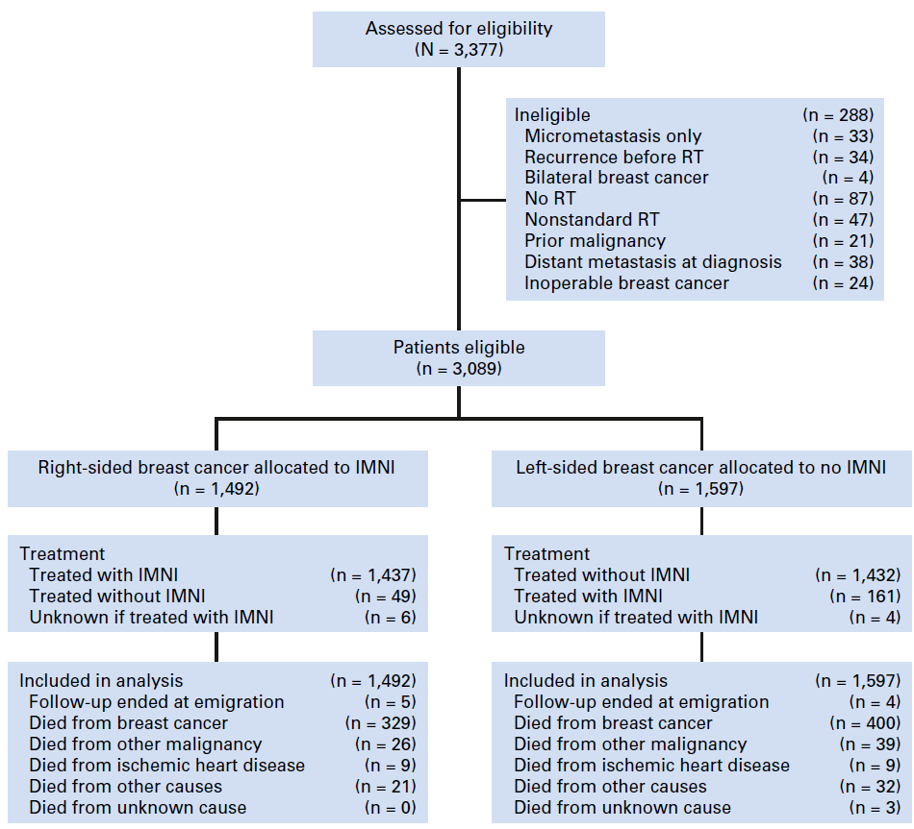
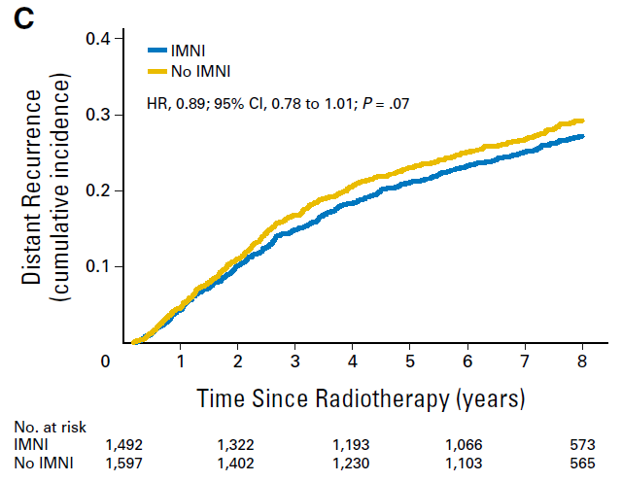
Population based Danish breast cancer cohort trial: N+, <70 y.
Whole breast (WBI)/chest wall (CWI) RT + supra/infracalv. RT
vs.
WBI/CWI + supra/infracalv. RT + internal mammary chain RT (IMC)
Overall Survival
+2.7%
Allocation by side:
Right sided: IMC-RT
Left sided: no IMC-RT
right sided cancer
left sided cancer
DMFS
Thorsen et al. JCO 2015

Slide 20
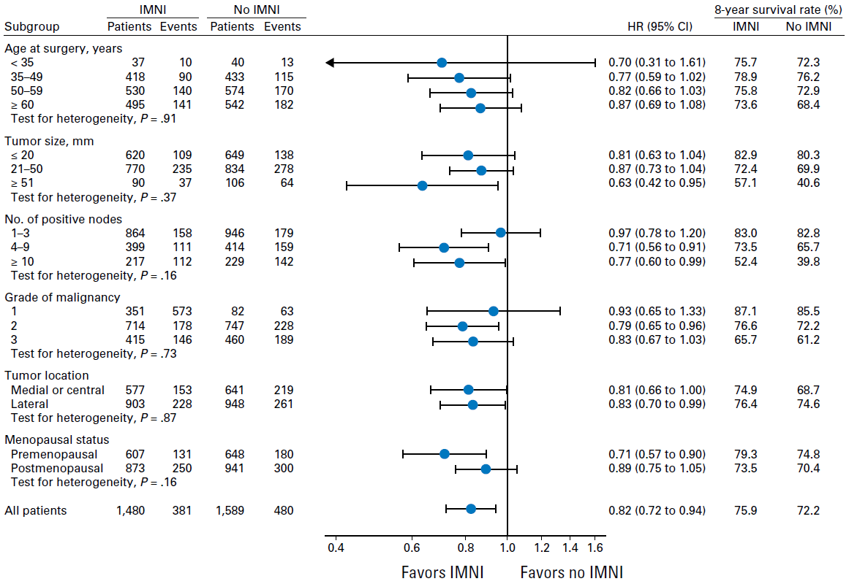
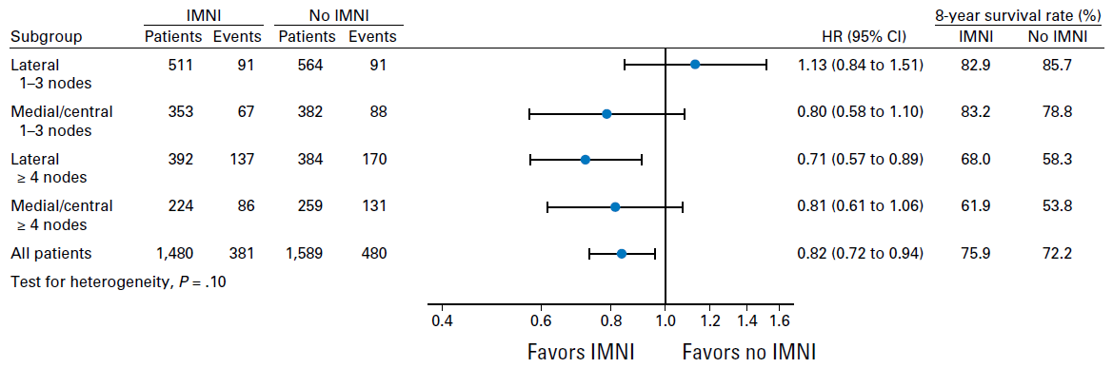
Overall survival: Population based Danish breast cancer cohort trial: N+, <70 y.
absolute benefit: +10%
absolute benefit: +8%
absolute benefit: +6%
absolute benefit: +8%
Thorsen et al. JCO 2015

Slide 21
Statements from the evidence based German S3-guideline 2017

Slide 23
noch nicht publiziert

Slide 24
Statements from the evidence based German S3-guideline 2017
unpublished

Slide 25
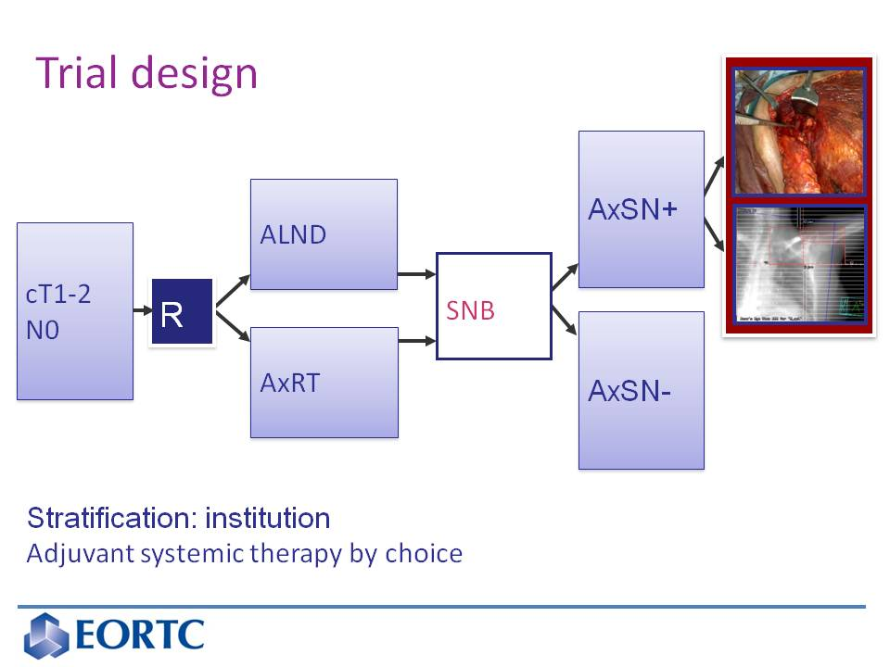
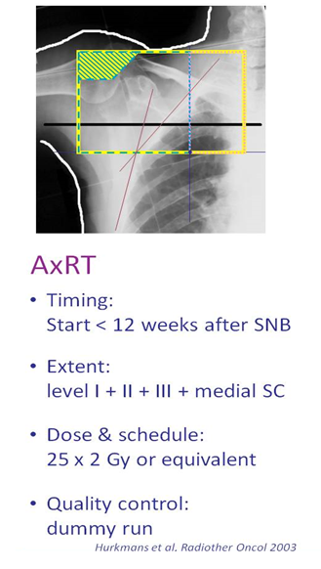
[TITLE]
EORTC 10981-22023 AMAROS
Rutgers et al. ASCO 2013; Donker et al. Lancet Oncol 2014

Slide 26
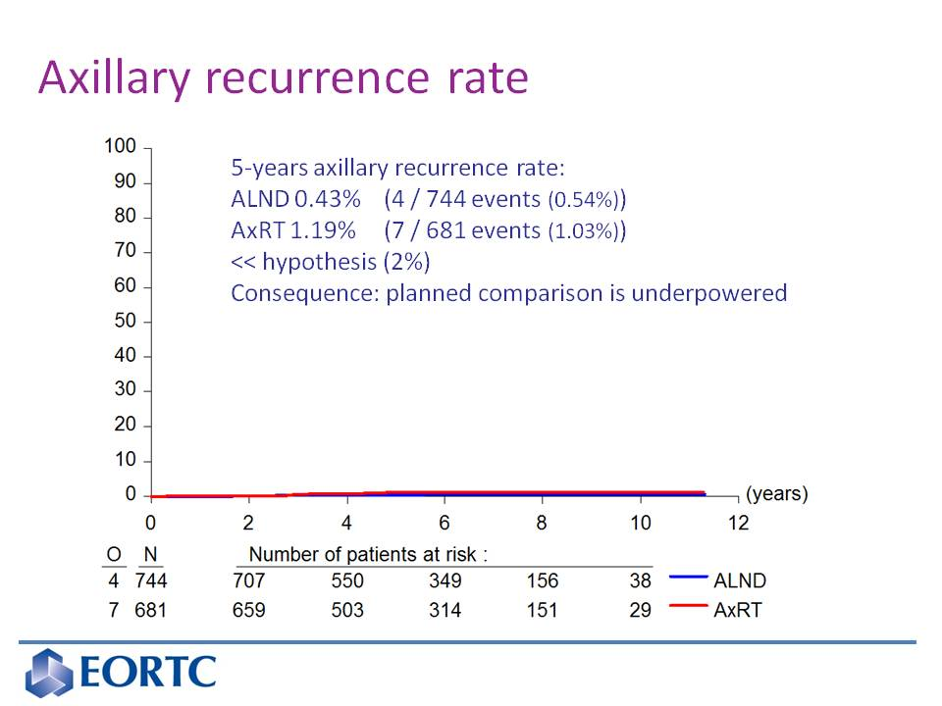
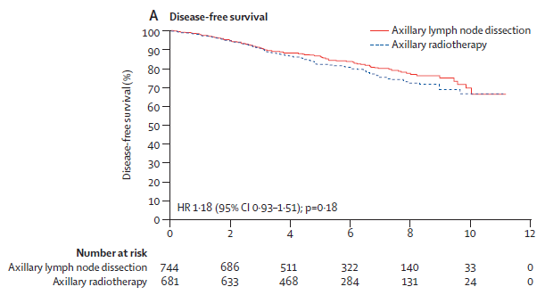
[TITLE]
EORTC 10981-22023 AMAROS
Rutgers et al. ASCO 2013; Donker et al. Lancet Oncol 2014

Slide 27
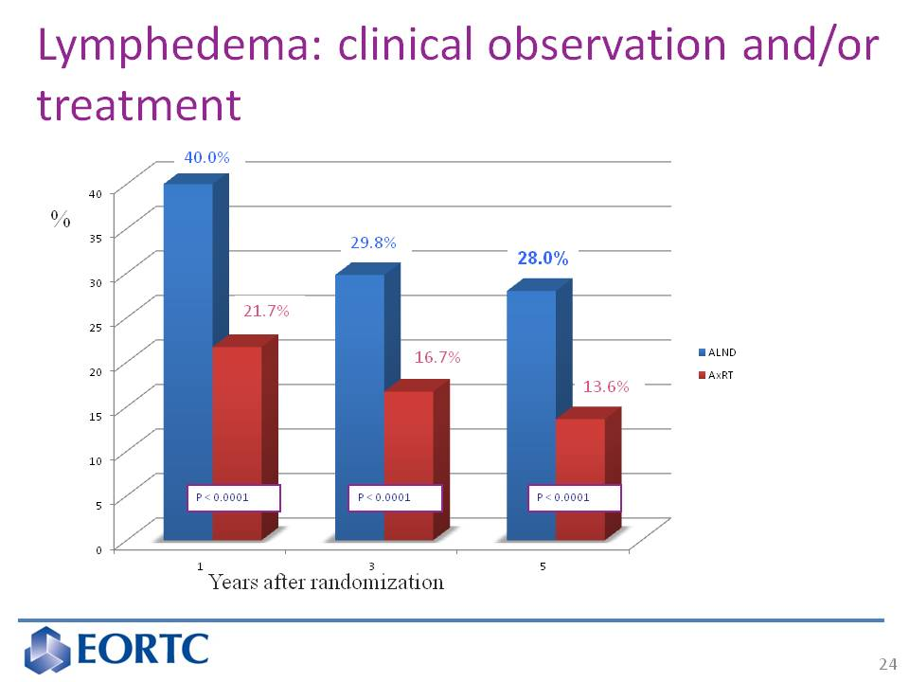
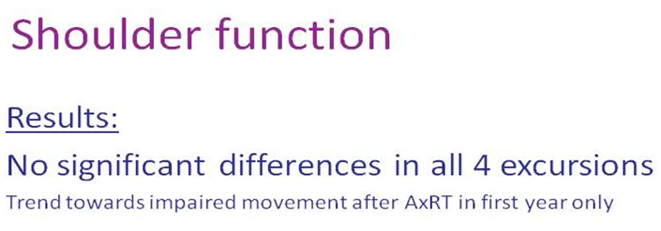
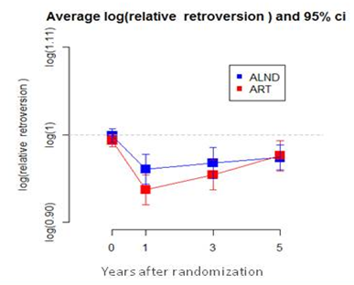
[TITLE]
Rutgers et al. ASCO 2013; Donker et al. Lancet Oncol 2014

Slide 28
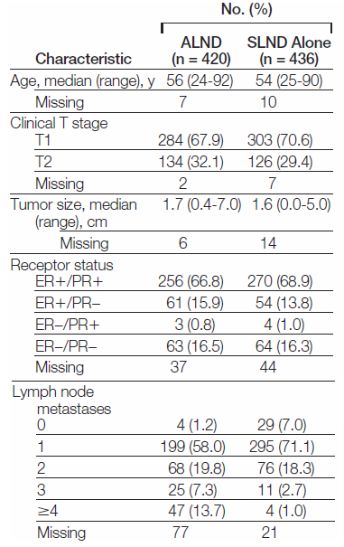
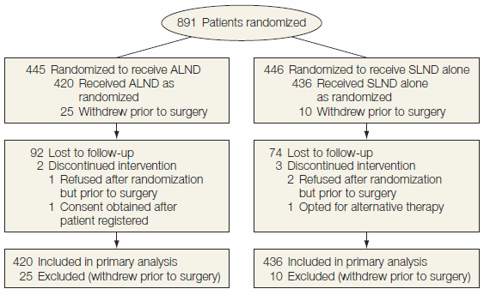
Management of the axilla: pos SNB: lymph node dissection vs. no LN-dissection
All patients received tangential radiotherapy to the breast
micrometastases
ALND: 137 of 365 (37.5%)
SLND: 164 of 366 (44.8%) (p=0.05)
Giuliano et al. JAMA 2011 Z0011 trial

Slide 29
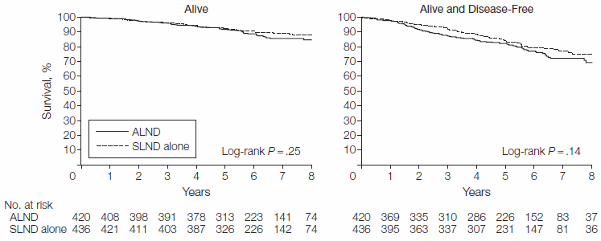
Management of the axilla: pos SNB: lymph node dissection vs. no LN-dissection
All patients were planned to receive tangential radiotherapy to the breast
Giuliano et al. JAMA 2011 Z0011 trial

Slide 30
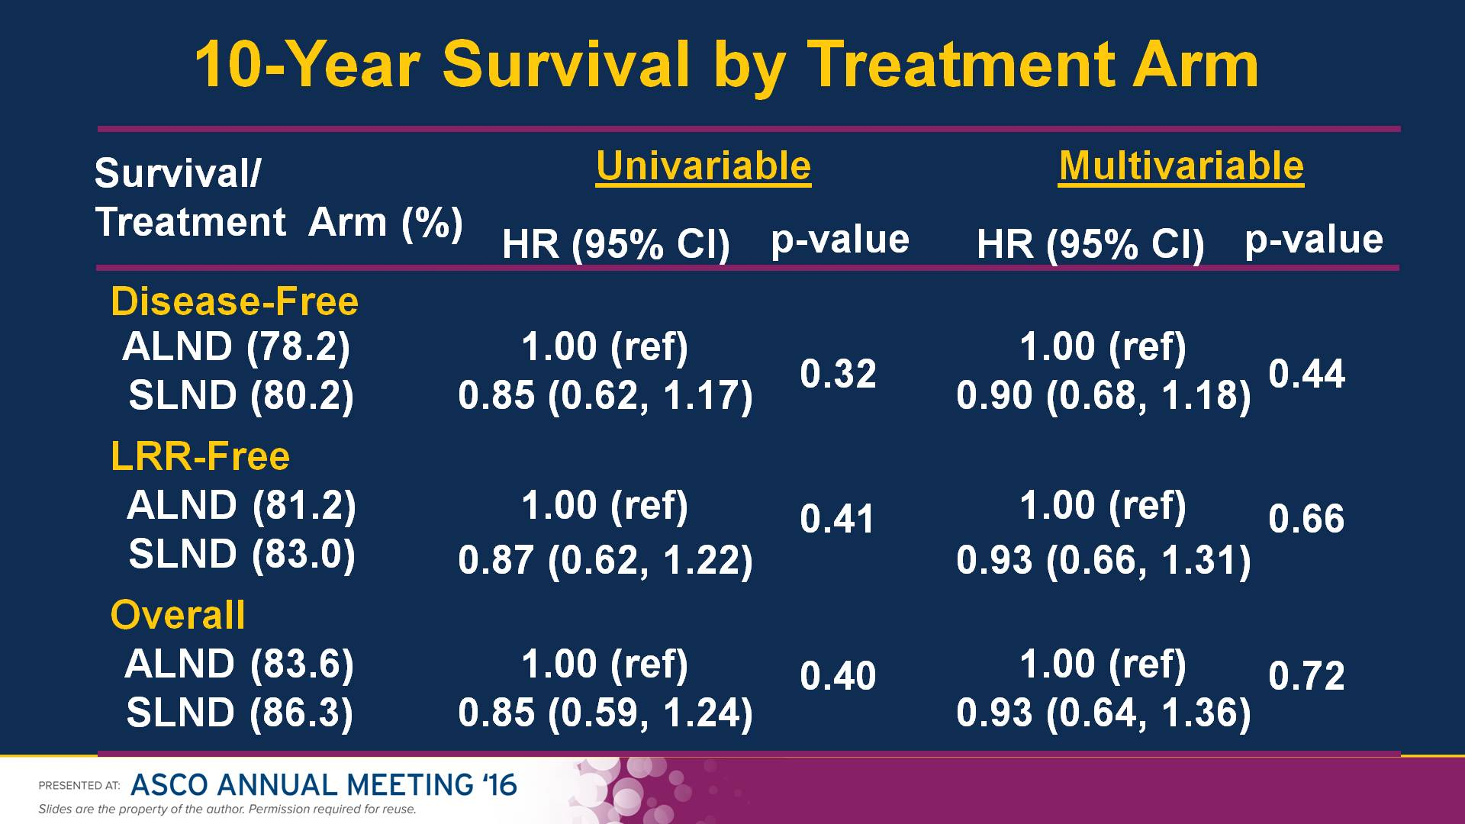
10-Year Survival by Treatment Arm
Management of the axilla: pos SNB: lymph node dissection vs. no LN-dissection
Presented By Armando Giuliano at 2016 ASCO Annual Meeting

Slide 31
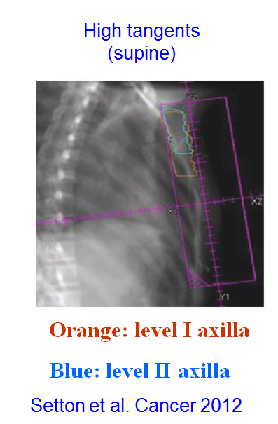
Management of the axilla: pos SNB: lymph node dissection vs. no LN-dissection
Use of RT in the Z001 trial (Data available in a subgroup)
supraclavicular
(SC) Field
Jagsi et al. JCO 2014

Slide 32
Statements from the evidence based German S3-guideline 2017

Slide 33
Summary
low risk patients (cT1-2cN0cM0, postmenopausal, G1) neither need axillary surgery nor lymph node RT
Axillary lymph node resection does not result in an clinical benefit in patients with 1-2 positive axillary lymph nodes, if at least whole breast RT is administered
Comprehensive lymph node RT improves survival in high risk N0 and intermediate and high risk N+ patients
Defined subgroups should receive comprehensive lymph node RT

Slide 34
Die Bestrahung der Lymphabflusswege
Ist bei Patientinnen mit erhöhten Rückfallrisiko eindeutig indiziert !

