Slide 1


Oxford-Diskussion:
Tamoxifen und CYP2D6-Bestimmung
C. Schumacher
Brustzentrum
St. Elisabeth-Krankenhaus
Notes:
1

Slide 2

Grundlagen

Slide 3
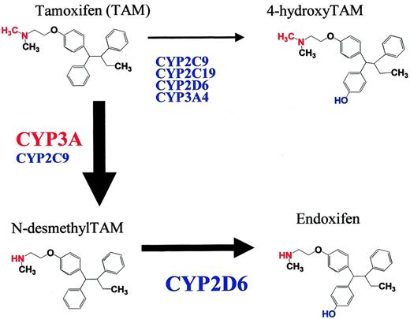
Tamoxifenmetabolismus
Tamoxifen wird in der Leber über das Cytochrom-P450-Enzymsystem, insbesondere über das Isoenzym CYP2D6, verstoffwechselt.
Die aktiven Metabolite
4-Hydroxy-tamoxifen (4-OHT, Afimoxifen)
und N-desmethyl-4-hydroxytamoxifen
(Endoxifen) haben eine 30-100 fach höhere
Affinität zum Östrogenrezeptor
Einflussfaktoren:
Enzymaktivität, Ko-Medikation,
Alter (höhere Endoxifenkonz. bei
älteren Pat.), Jahreszeit (im Winter
niedrigere Konzentrationen) u.a.

Slide 4
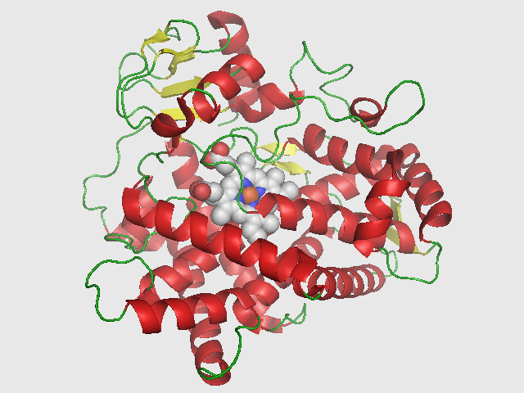
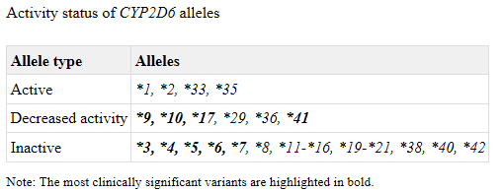
CYP2D6
Enzym aus der Cytochrom-P450-Gruppe,
die für die Metabolisierung von Lipiden, Hormonen, Toxinen und Medikamenten verantwortlich ist.
Komplexes Gen mit dem Auftreten von Deletionen, Duplikationen, Multiplikationen und Pseudogenen mit der Folge , dass die korrekte Bestimmung des Genotyps anspruchsvoll ist.
Genetische Tests sind verfügbar für ca. 30 Varianten der CYP2D6-Allele,
das Ergebnis wird meistens als Diplotyp mitgeteilt z.B. CYP2D6 *1/*1.

Slide 5
CYP2D6
Phänotypen:
- Langsame Meta­bolisierer (etwa 7 Prozent der Bevölkerung):
zwei nicht funktionelle Allele des CYP-2D6-Gens - es wird kein Protein gebildet und der
Metabolismus verläuft extrem langsam. Schon bei einer Standarddosierung ist mit der
Akkumulation von Substrat-Wirkstoffen zu rechnen. Bei einem Prodrug, das durch CYP2D6
aktiviert wird, werden andererseits keine ausreichenden Wirkstoffspiegel erzielt.
- Intermediäre Metabolisierer (etwa 40 Prozent der Bevölkerung):
ein nicht und ein eingeschränkt funktionelles Allel - daher werden Arzneistoffe mit
reduzierter Aktivität verstoffwechselt. Die resultierenden pharmakologischen Effekte ähneln
denen der PM in abgeschwächter Form.
- Extensive (»normale«) Metabolisierer (etwa 50 Prozent der Bevölkerung):
ein oder zwei voll funktionsfähige Allele - Arzneistoffe werden bei diesem Phänotyp effizient
metabolisiert, die Wirkung des Arzneistoffes entspricht den Erwartungen an eine
Standarddosierung.
- Ultraschnelle Metabolisierer (etwa 2 bis 3 Prozent der Bevölkerung):
aufgrund einer Genamplifikation drei oder mehr Kopien funktionsfähiger Gene -sie sprechen
selbst nach Gabe sehr hoher Dosen auf die Pharmakotherapie nicht an. Demgegenüber wird
bei der Applikation eines Prodrugs pro Zeiteinheit so viel der aktiven Wirkform gebildet, dass
toxische Konzentrationen erreicht werden können bzw. unerwünschte Arzneimittel
-wirkungen auftreten.
Mehr als
100 verschiedene Genotypen bekannt,
je nach Auswirkung
auf die Enzymaktivität
Einteilung in vier
Metabolisierungstypen:

Slide 6
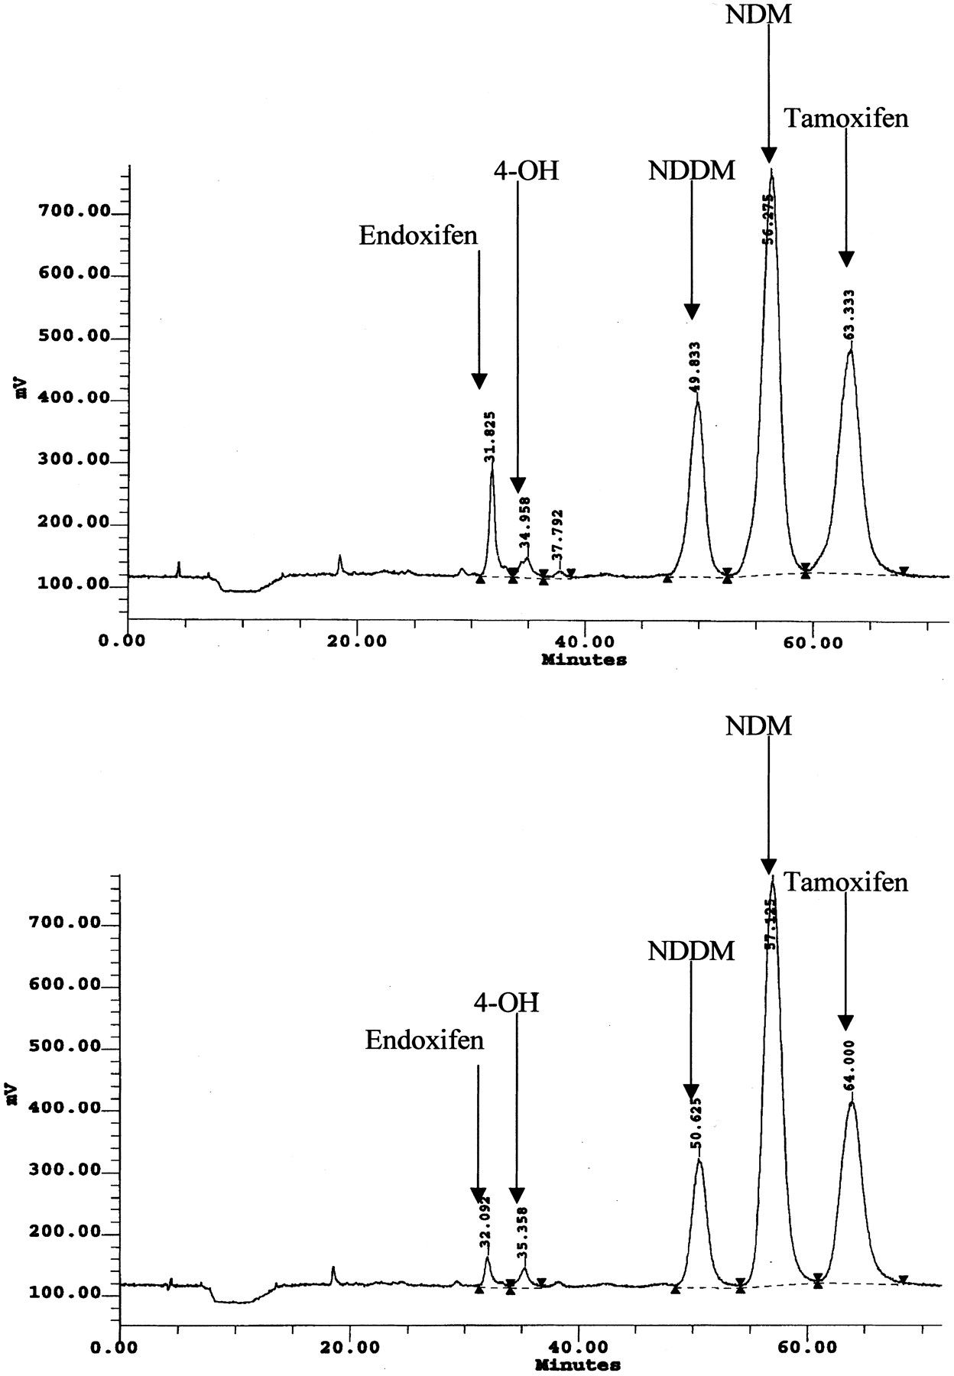
Active tamoxifen metabolite plasma concentrations after coadministration of tamoxifen and the selective serotonin reuptake inhibitor paroxetine.
Stearns V et al, J Natl Cancer Inst. 2003 Dec 3;95(23):1758-64.
Baseline blood samples were obtained to determine the CYP2D6 genotype and the plasma concentrations of tamoxifen and its metabolites. After 4 weeks of co-prescription of paroxetine and tamoxifen, a second blood sample was collected to measure the plasma concentrations of tamoxifen and its metabolites.
RESULTS:
Plasma concentrations of endoxifen statistically significantly decreased from a mean of 12.4 ng/mL before paroxetine coadministration to 5.5 ng/mL afterward (difference = 6.9 ng/mL, 95% confidence interval [CI] = 2.7 to 11.2 ng/mL) (P =.004).
Endoxifen concentrations decreased by 64% (95% CI = 39% to 89%) in women with a wild-type CYP2D6 genotype but by only 24% (95% CI = 23% to 71%) in women with a variant CYP2D6 genotype (P =.03).
before paroxetine after paroxetine

Slide 7
Ist die Bestimmung von CYP2D6 vor einer Tamoxifengabe sinnvoll?
Ja!
Meine Position:
Denn:
20-30% der Patientinnen, die leitliniengerecht Tamoxifen einnehmen, werden ein Rezidiv erleiden und einer der Gründe dafür liegt in einer unzureichenden Umsetzung von Tamoxifen in das wirksame Stoffwechselprodukt Endoxifen.
„20 mg Tamoxifen für alle“ ist im Zeitalter der personalisierten Medizin
nicht mehr akzeptabel!

Slide 8

Fakt 1:
Tamoxifen ist ein Prodrug und
Endoxifen ist der wesentliche aktive Metabolit

Slide 9
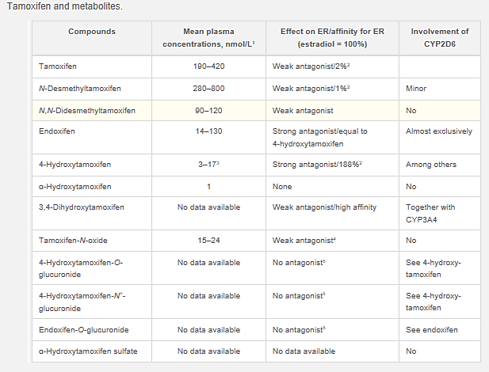
Pharmacogenomics of Tamoxifen Therapy
Brauch H et al, Clinical Chemistry Oct 2009, 55 (10) 1770-1782
RESULTS:
The number of tamoxifen metabolites that have been identified in vitro is large.
In vivo analytical measurements of plasma samples from tamoxifen-treated patients have quantified few metabolites, including N-desmethyltamoxifen, endoxifen, 4-hydroxytamoxifen, N,N-didesmethyltamoxifen, α-hydroxytamoxifen, and tamoxifen-N-oxide

Slide 10
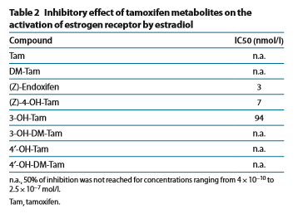
Activity levels of tamoxifen metabolites at the estrogen receptor and the impact of genetic polymorphisms of phase I and II enzymes on their concentration levels in plasma.
Mürdter TE et al. Clin Pharmacol Ther. 2011 May;89(5):708-17.
236 breast cancer patients were genotyped for CYP2D6, CYP2C9, CYP2B6, CYP2C19, CYP3A5, UGT1A4, UGT2B7, and UGT2B15; also, plasma concentrations of tamoxifen and 22 of its metabolites, including the (E)-, (Z)-, 3-, and 4′-hydroxymetabolites as well as their glucuronides, were quantified using liquid chromatography–tandem mass spectrometry. y (MS). The activity levels of the meta-bolites were measured using an estrogen response element reporter assay;
RESULTS:
The strongest estrogen receptor inhibition was found for (Z)-endoxifen and (Z)-4-hydroxytamoxifen -
inhibitory concentration 50 (IC50)
3 and 7 nmol/l, respectively.

Slide 11
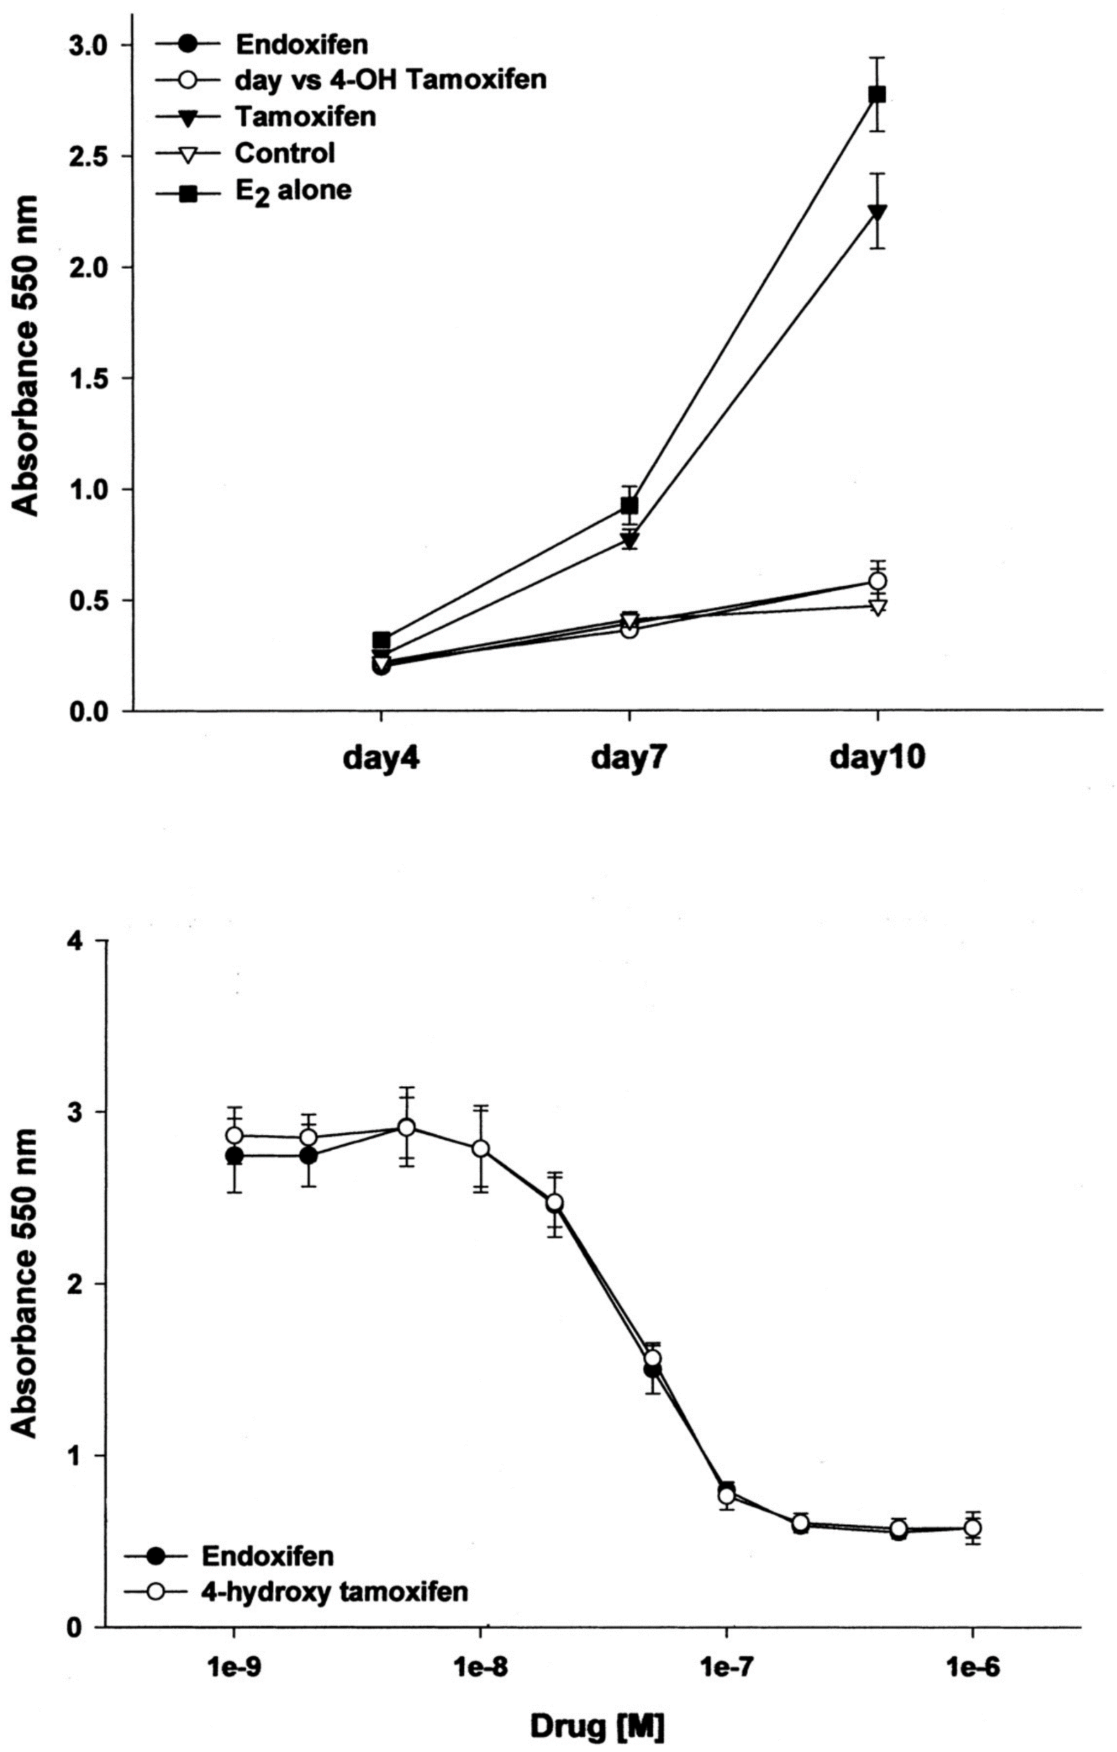
Active tamoxifen metabolite plasma concentrations after coadministration of tamoxifen and the selective serotonin reuptake inhibitor paroxetine.
Stearns V et al, J Natl Cancer Inst. 2003 Dec 3;95(23):1758-64.
Effects of tamoxifen, 4-hydroxy-tamoxifen, and endoxifen on estrogen-stimulated proliferation of MCF7 cells
RESULTS:
Both endoxifen and 4-hydroxy-tamoxifen (100 nM) suppressed estradiol (200 pM)-stimulated MCF7 proliferation to control levels (Fig. 3, upper panel).
Tamoxifen also inhibited proliferation, though less effectively than either metabolite.
A dose-response analysis revealed that endoxifen and 4-hydroxy-tamoxifen were equipotent in this system (P = .949 for the difference)
Plasma concentrations of 4-hydroxy-tamoxifen are low relative to those of N-desmethyl-tamoxifen, indicating that the primary route for metabolism of the parent drug, tamoxifen, is via N-demethylation
„We assessed whether endoxifen could negate the effect of estradiol in MCF7 cells, which are dependent on estrogen stimulation for their proliferation.“

Slide 12
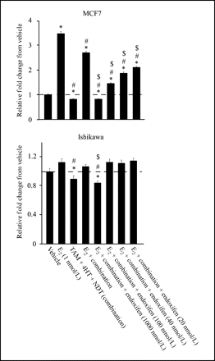
The Tamoxifen Metabolite, Endoxifen, is a Potent Antiestrogen that Targets Estrogen Receptor α for Degradation in Breast Cancer Cells
Wu X et al, Cancer Res 2009;69(5):1722–7
MCF7, T47D, and parental Hs578T cells were purchased from American Type Culture Collection. Ishikawa cells were purchased from Sigma-Aldrich
RESULTS:
Endoxifen is a potent antiestrogen that functions in part by targeting ERα for degradation by the proteasome in breast cancer cells.
Endoxifen blocks ERα transcriptional activity and inhibits estrogen-induced breast cancer cell proliferation even in the presence of tamoxifen, N-desmethyl-tamoxifen, and 4-hydroxytamoxifen.
All of the effects of endoxifen are concentration dependent and do not occur at concentrations observed in human CYP2D6 poor metabolizers.
These results support the theory that endoxifen is the primary metabolite responsible for the overall effectiveness of tamoxifen in the treatment of ER-positive breast cancer.

Slide 13
Fakt 2:
Der Endoxifenspiegel korreliert mit der Prognose.

Slide 14
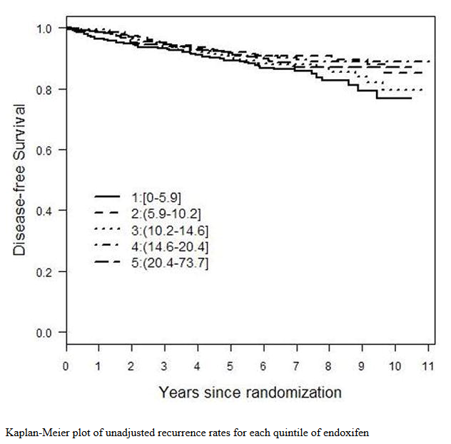
Tamoxifen Metabolite Concentrations, CYP2D6-Genotype
and Breast Cancer Outcomes
Madlensky L et al, Clin Pharmacol Ther. 2011; 89(5): 718–725.
Women’s Healthy Eating and Living (WHEL) Study
n=1370, pre- and postmenopausal
The Women's Healthy Eating and Living (WHEL) Study was a multisite randomized controlled trial of the effectiveness of a high-vegetable, low-fat diet, aimed at markedly raising circulating carotenoid concentrations from food sources, in reducing additional breast cancer events and early death in women with early-stage invasive breast cancer (within 4 years of diagnosis)
RESULTS:
Breast cancer outcomes were not associated with tamoxifen, 4-hydroxytamoxifen or N-desmethyltamoxifen concentrations.
For endoxifen, a threshold was identified suggesting that women in the upper four quintiles of endoxifen had a 26% lower recurrence rate than women in the bottom quintile.

Slide 15
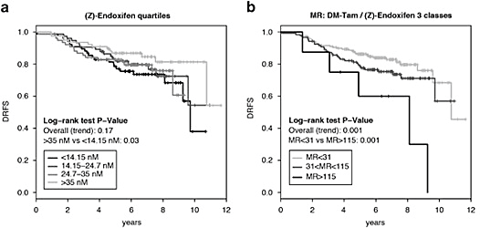
Tamoxifen metabolism predicts drug concentrations and outcome in premenopausal patients with early breast cancer
Saladores P et al, Pharmacogenomics J. 2015 Feb; 15(1): 84–94.
Three ethnic groups of prospectively recruited hormone receptor-positive premenopausal breast cancer patients with adjuvant tamoxifen treatment were investigated. Steady-state blood samples of patients treated with tamoxifen (20mg per day) were collected on-site within the ﬁrst year of treatment, n=587
RESULTS:
Improved distant relapse-free survival (DRFS) was associated with decreasing DM-Tam/(Z)-endoxifen (P=0.036) and increasing CYP2D6 activity score (hazard ratio (HR)=0.62; 95% confidence interval (CI), 0.43–0.91; P=0.013).
Low (<14 nM) compared with high (>35 nM) endoxifen concentrations were associated with shorter DRFS (univariate P=0.03; multivariate HR=1.94; 95% CI, 1.04–4.14; P=0.064).

Slide 16
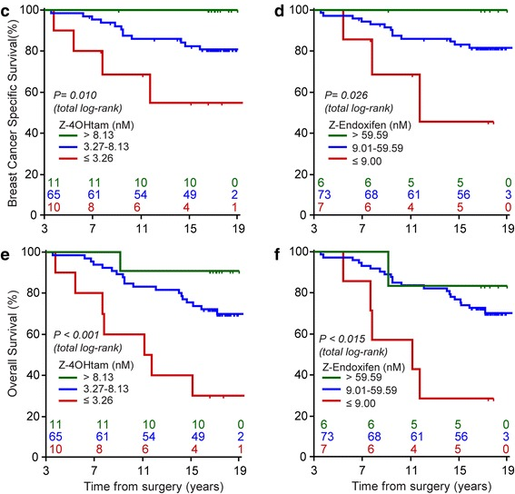
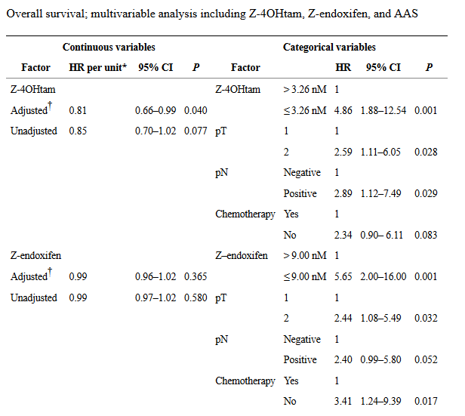
Serum concentrations of active tamoxifen metabolites predict
long-term survival in adjuvantly treated breast cancer patients
Thomas Helland et al, Breast Cancer Res. 2017; 19: 125
Serum was drawn from 356 relapse-free patients 3 years after inclusion. Of these, 99 operable BC patients comprising T1/T2 tumors were adjuvantly treated with tamoxifen and included in the present study. The median follow-up time for breast cancer death from this entry time was 13.9 years

Slide 17
Fakt 3:
Der Genotyp korreliert mit der Konzentration aktiver Metaboliten.

Slide 18
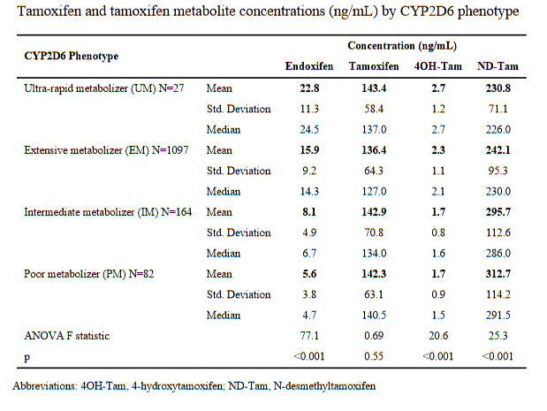

Tamoxifen Metabolite Concentrations, CYP2D6-Genotype
and Breast Cancer Outcomes
Madlensky L et al, Clin Pharmacol Ther. 2011; 89(5): 718–725.
N=1370,
Women’s Healthy Eating and Living (WHEL) Study
Predictors of membership in this higher risk bottom quintile were poor/intermediate metabolizer genotype, higher BMI, and low tamoxifen concentrations

Slide 19
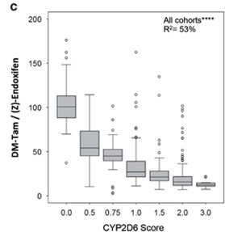
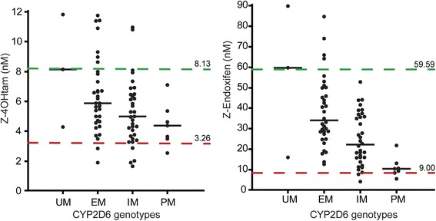
Tamoxifen metabolism predicts drug concentrations and outcome in premenopausal patients with early breast cancer
Saladores P et al, Pharmacogenomics J. 2015 Feb; 15(1): 84–94.
Serum concentrations of active tamoxifen
metabolites predict long-term survival in adjuvantly treated breast cancer patients
Thomas Helland et al, Breast Cancer Res. 2017; 19: 125
From an original observational study comprising 817 breast cancer patients, 99 women with operable breast cancer were retrospectively included in the present study. This cohort of patients were adjuvantly treated with tamoxifen, had provided serum samples suitable for measuring tamoxifen metabolites, and were relapse-free at 3 years after the primary treatment commenced. The median follow-up time from this entry point to breast cancer death was 13.9 years

Slide 20
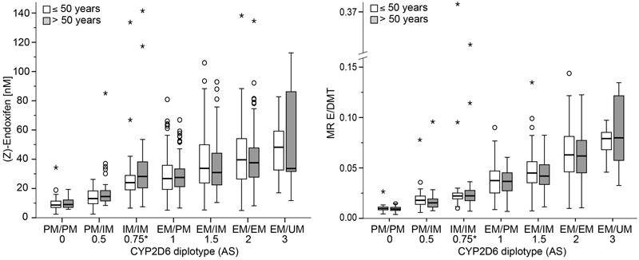
Improved Prediction of Endoxifen Metabolism by CYP2D6 Genotype
in Breast Cancer Patients Treated with Tamoxifen
Schroth W et al, Front Pharmacol. 2017; 8: 582
The genotype data and available TAM and TAM metabolite concentrations of 908 prospectively recruited ER-positive breast cancer patients that had received adjuvant TAM treatment (20 mg/d) for at least 6 months and who had TAM plasma concentrations above
150 nM as a threshold for compliance (Saladores et al., 2015) were included in this study.
N=898

Slide 21
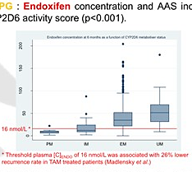
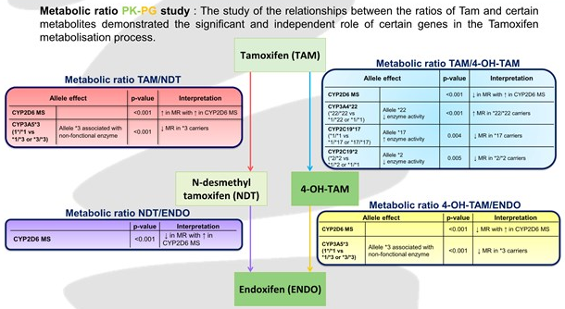
Impact of genetic polymorphisms on plasma levels of tamoxifen and its
metabolites and toxicity: 6-months results of the adjuvant breast cancer
longitudinal PHACS study
White-Koning M et al, SABCS 2017
n=879, Untersuchung 6 Monate nach Medikationsbeginn
Endoxifen concentration increases significantly with CYP2D6-MS (p<0,001)

Slide 22
Fakt 4:
Der Genotyp korreliert mit der Prognose.

Slide 23
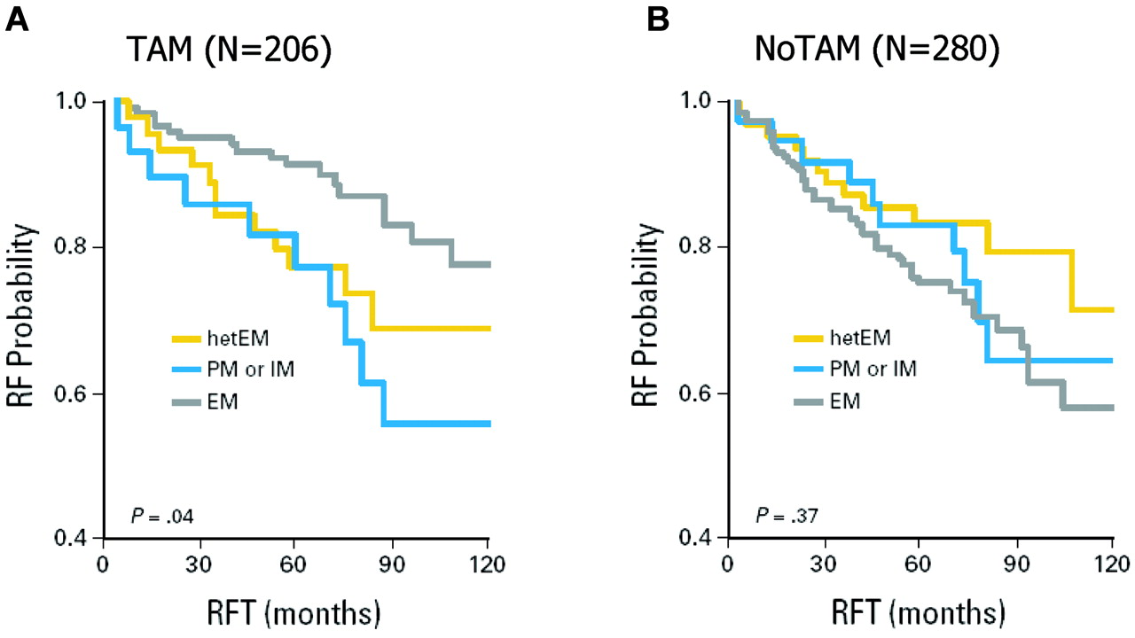
Breast cancer treatment outcome with adjuvant tamoxifen relative to patient CYP2D6 and CYP2C19 genotypes.
Schroth W et al, J Clin Oncol 2007;25:5187-5193
DNA from 206 patients receiving adjuvant tamoxifen monotherapy and from 280 patients not receiving tamoxifen therapy (71 months median follow-up) was isolated from archival material and was genotyped. The median postsurgery follow-up period was
71 months
RESULTS:
Tamoxifen-treated patients with impaired formation of antiestrogenic metabolites had significantly more recurrences of breast cancer, shorter relapse-free periods (hazard ratio [HR], 2.24; 95% CI, 1.16 to 4.33; P = .02), and worse event-free survival rates (HR, 1.89; 95% CI, 1.10 to 3.25; P = .02) compared with carriers of functional alleles.

Slide 24
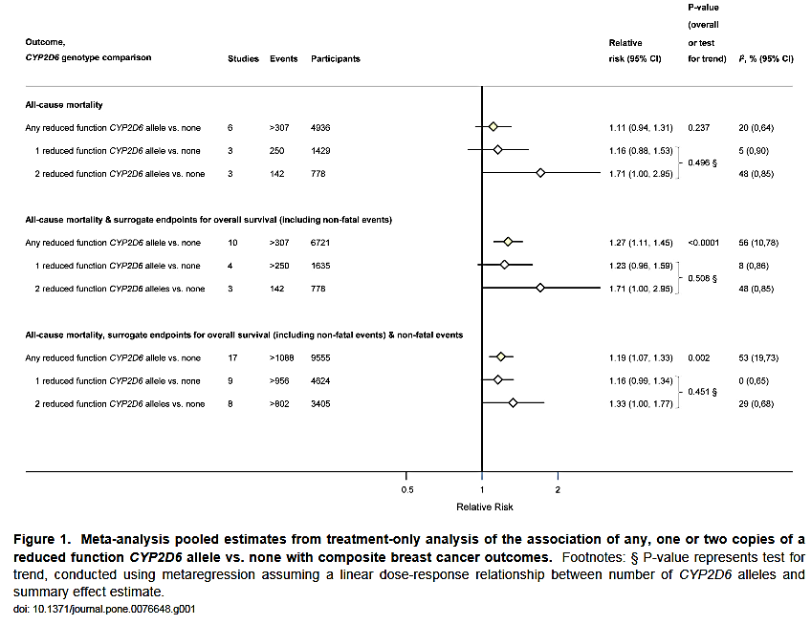
CYP2D6-Genotype and Tamoxifen Response for Breast Cancer:
A Systematic Review and Meta-Analysis
Lum DWK et al, PLOS ONE, October 2013 | Volume 8 | Issue 10 | e76648
Systematic review and meta-analysis of prospective, cross-sectional and case-control studies published to 2012.
N=13629
RESULTS:
A weak association between CYP2D6 genotype and surrogate endpoints for overall survival
No association between CYP2D6 genotype and tamoxifen response for all-cause mortality or overall survival
The current evidence does not support the use of CYP2D6 genotyping to guide tamoxifen prescribing for the treatment of breast cancer.

Slide 25
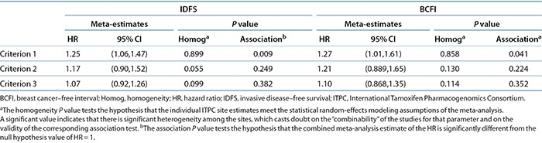
CYP2D6 Genotype and Adjuvant Tamoxifen: Meta-Analysis of Heterogeneous Study Populations
Province MA et al, Clin Pharmacol Ther. 2014 Feb; 95(2): 216–227
The ITPC comprises 12 research projects from nine countries and three continents that contributed clinical and genetic data for a total of 4,973 breast cancer patients treated with tamoxifen
RESULTS (n=4973):
Using strict eligibility requirements CYP2D6 poor metabolizer status was associated with poorer invasive disease–free survival.
Criterion 1: postmenopausal women with surgically resected nonmetastatic invasive ER-positive breast cancers who received adjuvant tamoxifen monotherapy at a dose of 20 mg/day for an intended duration of 5 years, and were followed at least annually for recurrence. In addition, analysis of at least CYP2D6*4 was required
Criterion 2 included criterion 1 but allowed both pre- and postmenopausal patients who had received any duration of tamoxifen; moreover, annual follow-up was not required.
Criterion 3 included all samples not excluded by any exclusion test for missing data or data inconsistencies (least restrictive)

Slide 26
Association between CYP2D6 genotypes and the
clinical outcomes of adjuvant tamoxifen for breast cancer: a meta-analysis
Jung JA et al., Pharmacogenomics. 2014 Jan;15(1):49-60
We performed a meta-analysis of ten previous clinical reports (n = 5183) to evaluate the association betweenCYP2D6 genotype and hazard ratios for the recurrence risk of breast cancer after postoperative tamoxifen treatment.
Results: (N=5183)
A significantly increased risk of breast cancer recurrence in patients carrying variant CYP2D6 genotypes was found in this investigation. The mean hazard ratios and 95% CI were 1.60 (1.04-2.47) in the random effect model implemented in R and 1.63 (1.01-2.62) in the random effect model in NONMEM.
A pooled analysis of CYP2D6 genotype in breast cancer prevention trials of low-dose tamoxifen.
Johansson H et al, Breast Cancer Res Treat. 2016 Aug;159(1):97-108
Four randomized breast cancer prevention trials of very-low-dose (1 mg/day, n = 52 or 10 mg/week, n = 152) or low-dose tamoxifen (5 mg/day, n = 171) were pooled.
Results:
After a median follow-up of 12 years, rapid metabolizers with prior history of breast neoplasms allocated to tamoxifen 5 mg/day had a 60 % reduction of risk of recurrences (HR = 0.40, 95 % CI: 0.16-0.99) compared to slow metabolizers.

Slide 27
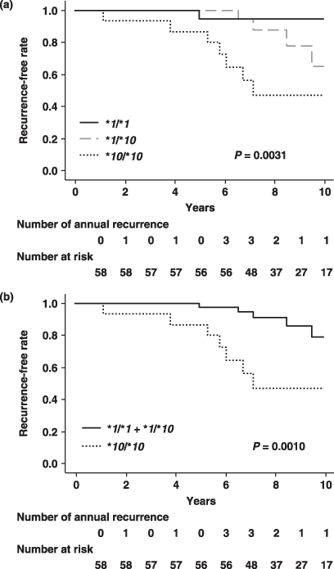
The effect of CYP2D6 *10 polymorphism on adjuvant tamoxifen in Asian breast cancer patients: a meta-analysis
Junjun Lu et al, Onco Targets Ther. 2017; 10: 5429–5437.
Results:
Patients homozygous for the CYP2D6*10 alleles revealed a significantly higher incidence of recurrence within 10 years after the operation (P = 0.0057; odds ratio, 16.63; 95% confidence interval, 1.75–158.12), compared with those homozygous for the wild-type CYP2D6*1 alleles.
CYP2D6 genotype and tumor size were independent factors affecting recurrence-free survival.
Patients with the CYP2D6*10/*10 genotype showed a significantly shorter recurrence-free survival period (P = 0.036; adjusted hazard ratio, 10.04; 95% confidence interval, 1.17–86.27) compared to patients with CYP2D6*1/*1 after adjustment of other prognosis factors.
Blood-DNA

Slide 28
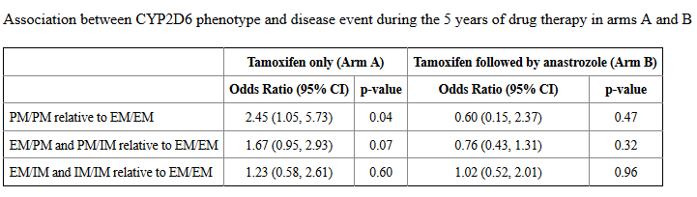
CYP2D6 Metabolism and Patient Outcome
in the Austrian Breast and Colorectal Cancer Study Group Trial (ABCSG) 8
Goetz MP et al, Clin Cancer Res. 2013 Jan 15; 19(2): 500–507.
A matched case–control study was conducted using the Austrian Breast and Colorectal Cancer Study Group Trial 8 (ABCSG8) that randomized postmenopausal women with estrogen receptor (ER)-positive breast cancer to tamoxifen for 5 years (arm A) or tamoxifen for 2 years followed by anastrozole for 3 years (arm B).
Cave:
Kurze Einnahme-dauer maskiert Effekt
Results:
In Arm A during the first 5 years of therapy, women with 2 poor alleles (PM/PM: OR=2.45, 95% CI: 1.05–5.73, p=0.04) and women with one poor allele (PM/IM or PM/EM: OR=1.67, 95% CI: 0.95–2.93, p=0.07) had a higher likelihood of an event than women with two extensive alleles (EM/EM).
In years 3–5 when patients remained on tamoxifen (Arm A) or switched to anastrozole (Arm B), PM/PM tended towards a higher likelihood of a disease event relative to EM/EM (OR= 2.40, 95% CI: 0.86–6.66, p=0.09) among women on Arm A but not among women on Arm B (OR= 0.28; 95% CI: 0.03–2.30).
The negative effects of reduced CYP2D6 metabolism were observed only during the period of tamoxifen administration and not after switching to anastrozole.

Slide 29
Fakt 4:
Therapeutische Alternativen stehen zur Verfügung bei schlechter Metabolisierung

Slide 30
Therapeutische Alternativen
Prämenopause
Wechsel auf GnRH + / - AI
Steigerung der Tamoxifen-Dosis
Gabe von Endoxifen
Postmenopause
Wechsel auf AI
Steigerung der Tamoxifen-Dosis
Gabe von Endoxifen
?
?

Slide 31
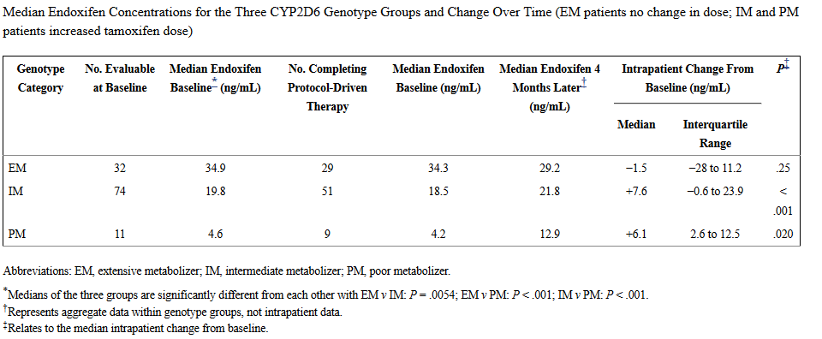
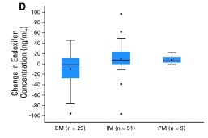
Genotype-Guided Tamoxifen Dosing Increases Active Metabolite Exposure in Women With Reduced CYP2D6 Metabolism: A Multicenter Study
William J. Irvin, Jr et al, J Clin Oncol. 2011 Aug 20; 29(24): 3232–3239
RESULTS:
The tamoxifen dose increase from 20 mg to 40 mg resulted in a significant rise in endoxifen concentrations in both IM
(P < .001) and PM (P = .020) patients. After 4 months, there was no significant difference in median endoxifen concentrations between EM taking 20 mg and IM taking 40 mg (P = .84) even though the baseline median endoxifen concentration was almost twice as great for the EM than for the IM group.

Slide 32
Adjusting the dose of tamoxifen in patients with early breast cancer and
CYP2D6 poor metabolizer phenotype
de Dueñas EM et al, The Breast Volume 23, Issue 4, August 2014, Pages 400-406
RESULTS:
The mean baseline endoxifen concentration in EM patients (11.30 ng/ml) was higher compared to the PM patients (2.33 ng/ml; p < 0.001). In relation to the 20 mg dose, increasing the tamoxifen dose to 40 and 60 mg in PM patients significantly raised the endoxifen concentration to 8.38 ng/ml (OR 3.59; p = 0.013) and to 9.30 ng/ml (OR 3.99; p = 0.007), respectively. These concentrations were comparable to those observed in EM patients receiving 20 mg of tamoxifen (p = 0.13 and p = 0.64, respectively).
Increasing tamoxifen Dose in Breast cancer Patients Based on CYP2D6 Genotypes and Endoxifen Levels: Effect on Active Metabolite Isomers and the Antiestrogenic Activity Score
Barginear MF et al., Clin. Pharmacol. Ther. 2011, 90:605-611
RESULTS:
In summary, increasing the Tam dose in patients with low (i.e., <40 nmol/l) plasma endoxifen levels and/or CYP2D6 poor metabolizer activity can increase the concentration of the active Tam metabolites.

Slide 33
First-in-Human Phase I Study of the Tamoxifen Metabolite Z-Endoxifen
in Women With Endocrine-Refractory Metastatic Breast Cancer
Goetz MP et al, Journal of Clinical Oncology 35, no. 30 (October 2017) 3391-3400
RESULTS:
Of 41 enrolled patients, 38 were evaluable for MTD determination. Prior endocrine regimens during which progression occurred included aromatase inhibitor (n = 36), fulvestrant (n = 21), and tamoxifen (n = 15). Patients received endoxifen once daily at seven dose levels (20 to 160 mg). Dose escalation ceased at 160 mg per day given lack of MTD and endoxifen concentrations > 1,900 ng/mL. Endoxifen clearance was unaffected by CYP2D6 genotype. Overall clinical benefit rate (stable > 6 months [n = 7] or partial response by RECIST criteria [n = 3]) was 26.3%
Concomitant use of tamoxifen and endoxifen in postmenopausal early breast cancer: prediction of plasma levels by physiologically-based pharmacokinetic modeling
Dickschen, K. et al. Springer Plus (2014) 3: 285
RESULTS:
Our virtual study demonstrates that dose escalation of tamoxifen in IMs resulted in endoxifen steady-state plasma concentrations similar to CYP2D6 EMs whereas PMs did not reach EM endoxifen levels. Steady-state plasma concentrations of tamoxifen, N-desmethyl-tamoxifen, 4-hydroxy-tamoxifen and endoxifen were similar in CYP2D6 IMs and PMs versus EMs using once daily dosing of 20 mg tamoxifen and concomitant CYP2D6 phenotype-adjusted endoxifen dosing in IMs and PMs (1 mg/d and 3 mg/d, respectively).
Verbesserte endokrine Therapie beim Mammakarzinom: Machbarkeitsnachweis der Supplementierung einer Standard-TAMoxifentherapie mit dem aktiven Metaboliten ENDOXifen
Gefördert durch:

Slide 34


Verbesserte endokrine Therapie beim Mammakarzinom: Machbarkeitsnachweis der Supplementierung einer Standard-TAMoxifentherapie mit dem aktiven Metaboliten ENDOXifen
Gefördert durch:
Prospektive, 3armige, multizentrische, verblindete, Placebo-kontrollierte, pharmakokinetische Studie
Patientinnen erhalten zusätzlich zu Tamoxifen Endoxifen in einer Dosis, die anhand des CYP2D6-Genotypes
bestimmt wird.
2. Patientinnen erhalten zusätzlich zu Tamoxifen Endoxifen in einer Dosis, die anhand des Endoxifen-
Plasmaspiegels unter Standard-Tamoxifentherapie bestimmt wird.
3. Patientinnen erhalten ausschließlich Tamoxifen.
Verbesserte endokrine Therapie beim Mammakarzinom: Machbarkeitsnachweis der Supplementierung einer Standard-TAMoxifentherapie mit dem aktiven Metaboliten ENDOXifen
Gefördert durch:

Slide 35
Fakt 5:
Die wichtigsten
Negativ-Studien zeigen erhebliche Mängel.

Slide 36
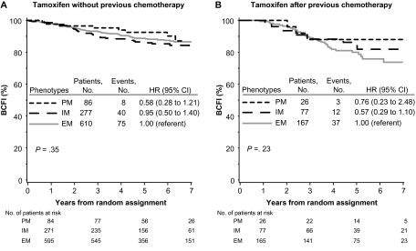
CYP2D6 Genotype and Tamoxifen Response in Postmenopausal Women with Endocrine-Responsive Breast Cancer: The Breast International Group 1-98 Trial (BIG-Trial)
Regan MM et al, J Natl Cancer Inst. 2012 Mar 21; 104(6): 441–451.
We obtained tumor tissues and isolated DNA from 4861 of 8010 postmenopausal women with hormone receptor–positive breast cancer who enrolled in the randomized, phase III double-blind Breast International Group (BIG) 1-98 trial between March 1998 and May 2003 and received tamoxifen and/or letrozole treatment.
RESULTS:
CYP2D6 metabolism phenotypes showed no association with breast cancer-free interval among patients who received tamoxifen.

Slide 37
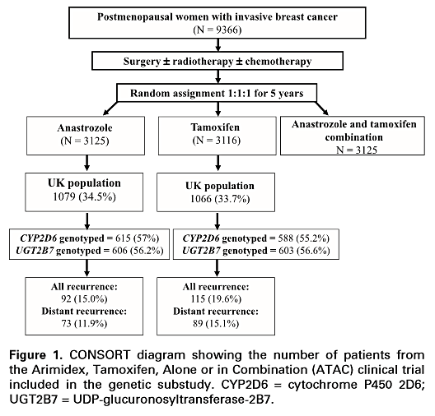
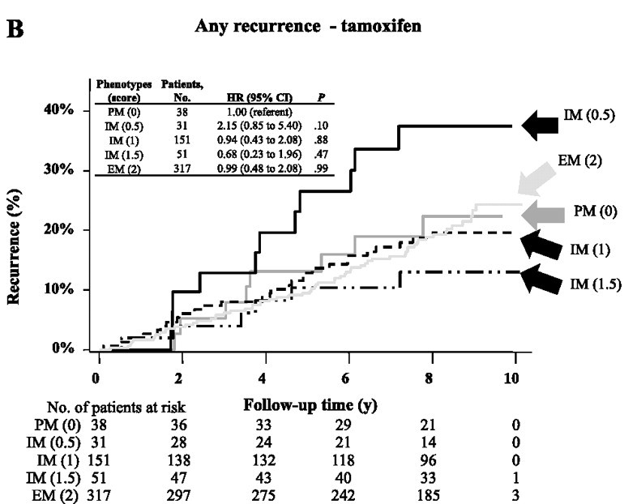
CYP2D6 and UGT2B7 Genotype and Risk of Recurrence in Tamoxifen-Treated
Breast Cancer Patients (ATAC-Study)
Rae JM et al, J Natl Cancer Inst. 2012 Mar 21; 104(6): 452–460.
Tumor specimens from a subset of postmenopausal patients with hormone receptor–positive early-stage (stages I, II, and IIIA) breast cancer, who were enrolled in the randomized double-blind Arimidex, Tamoxifen, Alone or in Combination (ATAC) clinical trial, were genotyped .
RESULTS:
After a median follow-up of 10 years, no statistically significant associations were observed between CYP2D6 genotype and recurrence in tamoxifen-treated patients (PM vs EM: HR for distant recurrence = 1.25, 95% CI = 0.55 to 3.15, P = .64; HR for any recurrence = 0.99, 95% CI = 0.48 to 2.08, P = .99).

Slide 38
CYP2D6 genotype in relation to tamoxifen efficacy in a Dutch cohort of the tamoxifen exemestane adjuvant multinational (TEAM) trial.
Dezentjé VO et al, Breast Cancer Res Treat. 2013 Jul;140(2):363-73
RESULTS:
No association was found between the CYP2D6 genotype or predicted phenotype and DFS-t (poor vs. extensive metabolizers: unadjusted hazard ratio 1.33, 95 % CI 0.52-3.43; P = 0.55).
Our study is the first CYP2D6 association study using DNA from paraffin-embedded tumor tissue in which potentially false interpretation of genotyping results because of LOH was excluded.
CYP2D6 genotype is not associated with survival in breast cancer patients treated with tamoxifen: results from a population-based study.
Hertz DL et al, Breast Cancer Res Treat. 2017 Nov;166(1):277-287
Tumor-derived DNA was genotyped for common, functionally consequential CYP2D6 polymorphisms
Results:
This population-based study does not support the hypothesis that patients with diminished CYP2D6 activity achieve inferior tamoxifen benefit.

Slide 39
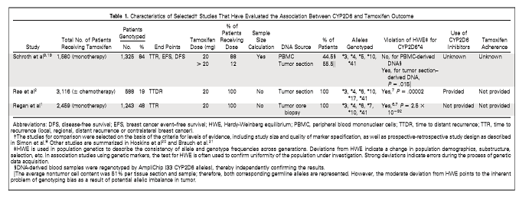
Kritikpunkte
Analyse von DNA aus Tumormaterial anstelle von Keimbahn-DNA
aus dem Blut (Leukozyten) oder aus Wangenabstrichen
Risiko: Fehlbestimmungen des Genotyps aufgrund von somatischen Mutationen mit Verlust der Heterozygotie in 30% der
Tumore
Testung: Bestimmung des Hardy-Weinberg Gleichgewichts (mathematische Ermittlung von Genhäufigkeiten in idealen
Populationen)
Brauch H et al, J Clin Oncol. 2013 Jan 10;31(2):176-80

Slide 40
Kritikpunkte
BIG, ATAC: kleine Subgruppenanalysen
- Verletzung der Schlüselanforderung nach Simon für Biomarkerstudien: mindestens Zweidrittel der
Studienpatientinnen sollten erfasst warden.
- Lt. Schroth et al wären mehr als 1200 Patientinnen der ATAC Studie erforderlich gewesen, um eine
HR von 1,85 zwischen CYP2D6 - PM und CYP2D6-EM mit 90%iger Power zu detektieren.
Grundsätzliche Probleme aller vorliegenden Studien:
zum Teil
fehlende Berücksichtigung der Komedikation, eingeschränkte Qualität der Genotyptestung, nicht ausreichende
Abdeckung der genetischen Varianten, unterschiedliche Kriterien für die Probengewinnung,
Nichtberücksichtigung der Therapieadhärenz

Slide 41
Ist die Bestimmung von CYP2D6 vor einer Tamoxifengabe also sinnvoll?
Ja!
Nach Darstellung der Studiendaten eindeutig
Wahrscheinlich ist die Kombination einer Upfront-Genotyp-Testung mit einem therapeutischem Drug-Monitoring von aktiven Metaboliten
als personalisierte Tamoxifentherapie der optimale Weg.
„20 mg Tamoxifen für alle“ ist im Zeitalter der personalisierten Medizin
nicht mehr akzeptabel!

Slide 42

Vielen Dank für Ihre Aufmerksamkeit!
Notes:
42

